Slide 1

Sprocket Central Pty Ltd
Prepared by: Olga Kantceva
Date: 27 January 2026

Slide 2
Agenda
Introduction
Data Exploration
Model Development
Interpretation

Slide 3
Introduction
The purpose of this project is to identify high-value customers for Sprocket Central Pty Ltd. First, we analyzed historical customer and transaction data to understand which customers bring the most value to the business. Then, we applied these insights to select the most promising customers from the new dataset of 1,000 potential clients.

Slide 4
Data Exploration
Dataset Overview
The analysis is based on three historical datasets:
Customer Demographic: customer profiles and personal characteristics.
Customer Address: location and geographic information.
Transactions: purchase history and transaction details.
In addition, a new dataset containing 1,000 potential customers was provided for target customer selection.

Slide 5
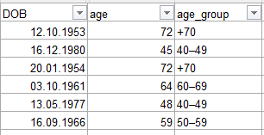
Data Exploration
Customer Distribution by Age Group
Age was calculated based on Date of Birth, and customers were grouped into age segments to support demographic analysis.
Sample of age calculation and grouping

Slide 6
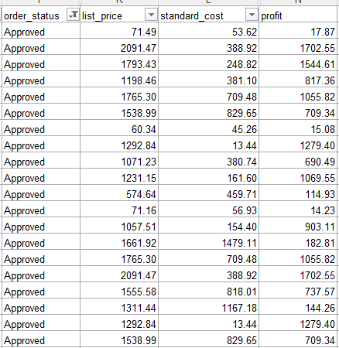
Data Exploration
Profit Calculation Logic
Profit was calculated as the difference between list price and standard cost. Only Approved transactions were included to ensure accurate profit estimation.
Sample of profit calculation based on approved orders

Slide 7
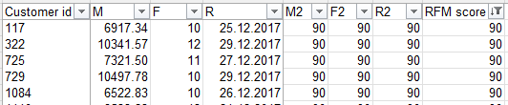
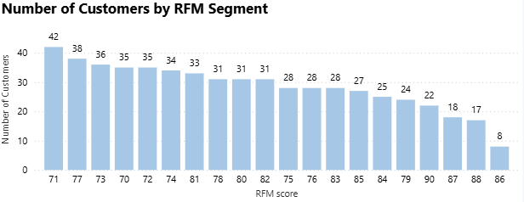
Data Exploration
RFM Analysis – Customer Segmentation
RFM analysis was applied to segment customers based on their purchasing behavior: Recency – how recently the customer made their last transaction. Frequency – how often the customer makes purchases. Monetary – how much the customer spends.
The chart shows the distribution of customers across RFM segments and highlights the segments with the highest concentration of valuable customers.

Slide 8
Data Exploration
Data Integration – Merging RFM with Customer Profile
First, the RFM table was merged with the Customer Demographic dataset using customer_id. This allowed us to enrich RFM scores with customer attributes such as age, gender, job industry, wealth segment and purchasing behavior.
After merging the datasets, a small number of records (19 rows) were found to contain missing key attributes and were therefore excluded from further analysis. This step ensured data consistency and improved the clarity and reliability of visualizations.

Slide 9
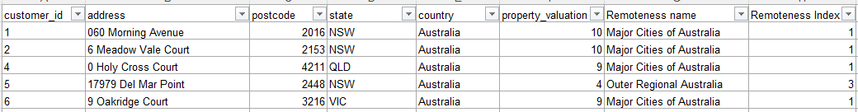
Data Exploration
Data Enrichment – Adding Geographic Information
The CustomerAddress table initially contained only street-level information, which was not sufficient for geographic segmentation.
Using postcode data, an external reference table with remoteness classifications was applied.
As a result, the Remoteness name and Remoteness Index were added to enrich the dataset with geographic context for further analysis.

Slide 10
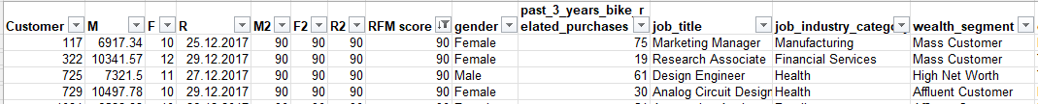
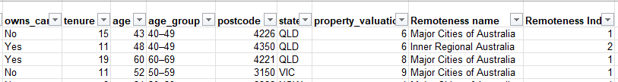
Data Exploration
Final Dataset – Complete Customer Profile
The final dataset integrates RFM metrics, customer demographics, and geographic information into a single customer profile.
This unified view enables accurate identification and segmentation of high-value customers.

Slide 11
Data Exploration
Who Are the Best Customers?
The best customers were identified using a weighted RFM model: • Monetary (50%) – customers who generate the highest revenue • Frequency (30%) – customers who purchase most often • Recency (20%) – customers who made purchases most recently
For further analysis, we selected customers with RFM scores between 70 and 90, as they represent the most valuable and loyal customer segment.

Slide 12
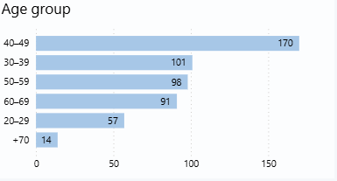
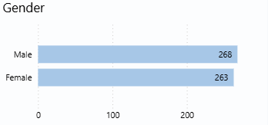
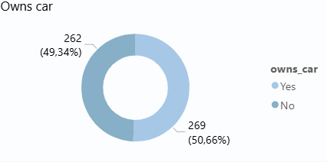
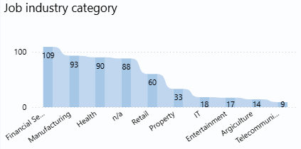
Model Development
Patterns of High-Value Customers

Slide 13
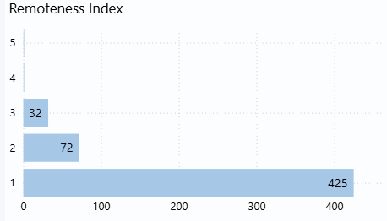
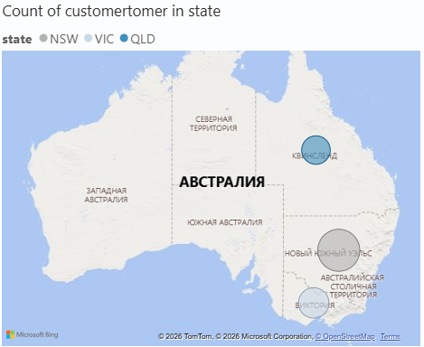
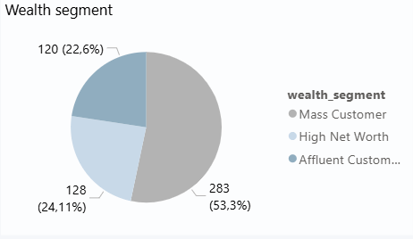
Model Development
Patterns of High-Value Customers (geography and wealth segment)

Slide 14
Interpretation
Business Recommendations
1. Focus marketing campaigns on customers living in Major Cities of Australia, with a special emphasis on NSW, as this region shows the highest concentration of high-value customers.
2. Prioritize customers aged between 40 and 49, since this age group generates the highest profit and demonstrates the most active purchasing behavior.
3. Do not limit targeting only to High Net Worth customers. More than half of high-value customers belong to the Mass Customer segment, which shows that purchasing behavior is more important than declared wealth.
4. Do not use car ownership as a primary targeting criterion. The distribution between customers who own a car and those who do not is almost balanced, which means this feature does not significantly differentiate high-value customers.

Slide 15
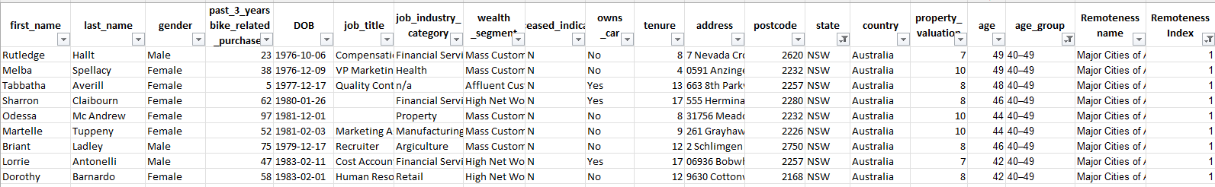
Interpretation
Business Recommendations
Based on the identified high-value customer profile, the new dataset was segmented. As a result, 79 customers with the highest potential were identified and selected for targeted marketing activities.

Slide 16
Appendix

Slide 17
Appendix
All supporting tables, calculations, and intermediate datasets used in this project are available in the Google Sheets linked below:
https://docs.google.com/spreadsheets/d/1PZTOM00NtGq-AyDYjsAjwbjtWPX7fswK/edit?usp=sharing&ouid=103404109642255735462&rtpof=true&sd=true
https://docs.google.com/spreadsheets/d/1x6boy0oT-MEvG4w6c9kDmPwWNjz69xnf/edit?usp=sharing&ouid=103404109642255735462&rtpof=true&sd=true

